Slide 1
Group C Crypto Algorithm Image
Made By: Kegan Lavoy, Daris Lychuk, Jamie Plunkett

Slide 2
Requirement 1

Slide 3
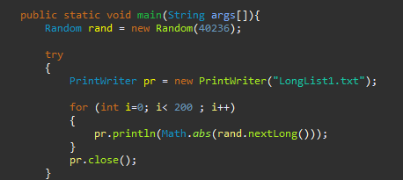
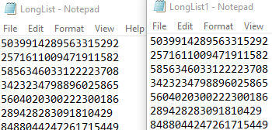
Req. 1: Generating long list of ints
Using a simple for loop, generated 200 long int numbers using a long int seed
Print results to a text file for comparison later

Slide 4
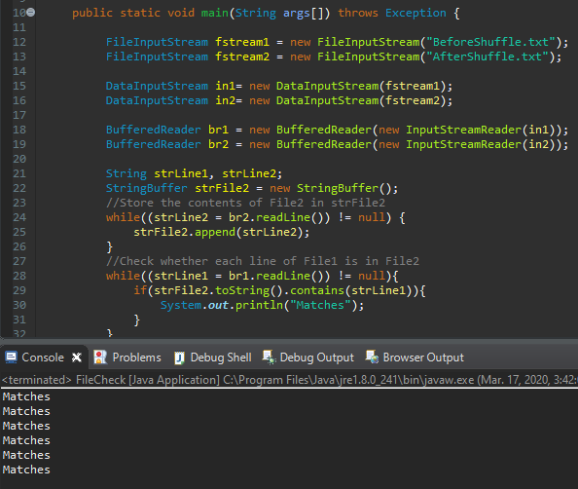
Req. 1: Comparison
Takes 2 text files as input
Compares files line by line
If the 2 lines being compared are the same, print “Matches”, else print different

Slide 5
Requirement 2

Slide 6
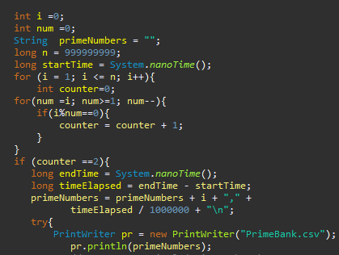
Req. 2: Prime Number Generation
Tests numbers for primality using modulo division
Increases a counter when a modulo division = 0
If counter becomes greater than 2, number is not prime

Slide 7
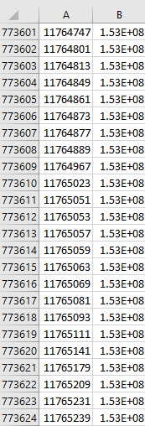
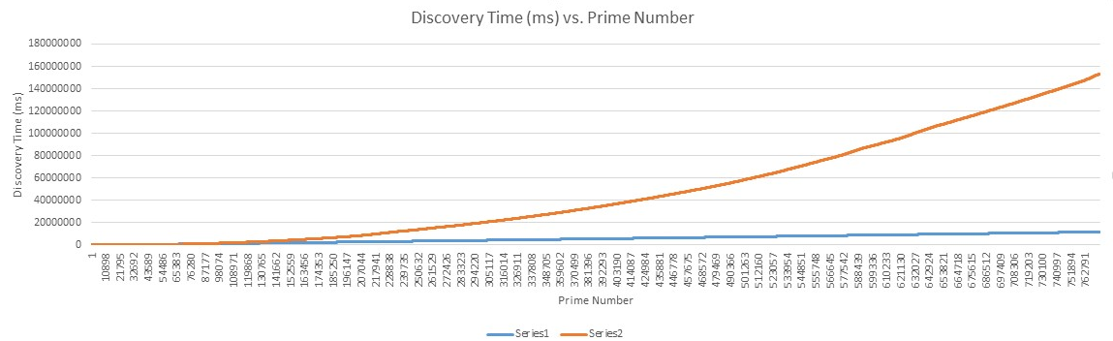
Req. 2: Prime Number Graphs

Slide 8
Requirement 3

Slide 9
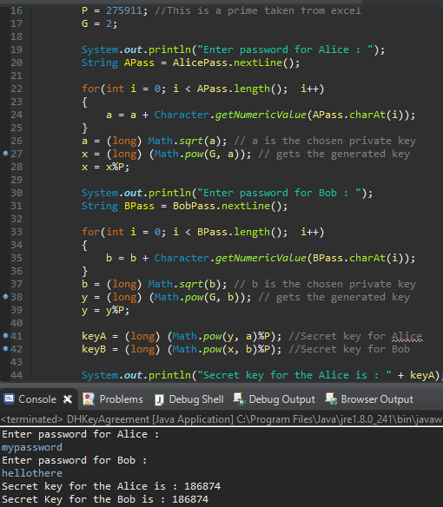
Req. 3: Bob/Alice Key Generation
Get two passwords from user, turn into ints for DH algorithm
Apply DH algorithm and use shared key in next steps

Slide 10
Requirement 4

Slide 11
Req. 4: Shared Key test on random ints
Used shared key generated by passwords as a check for other functions
This was tested before in the previous requirements

Slide 12
Requirement 5

Slide 13
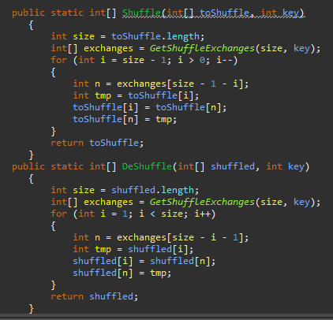
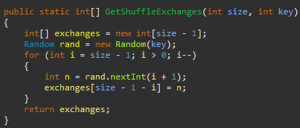
Req. 5: Shuffle Algorithms
Uses shared key as a seed for random number generator
Applies shuffling algorithm to reorder pixels in the array

Slide 14
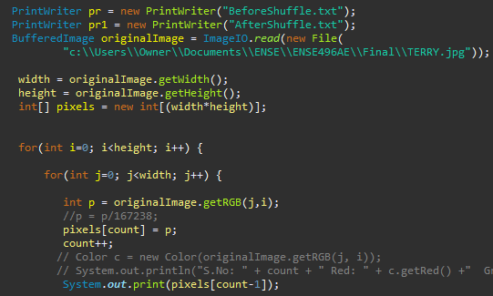
Req. 5: Image Shuffle
Load in an image and extract all pixel values into a 1D array
Shuffle that array using shared key as parameter and set new location for pixels

Slide 15
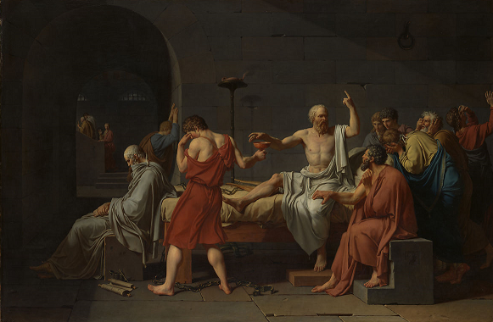

Req. 5: Shuffled Image example

Slide 16
Req. 5: DeShuffle
Call deshuffle using same shared key as a parameter
Reinsert pixels into their proper places

Slide 17
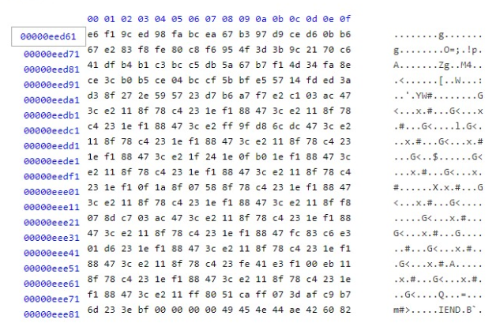
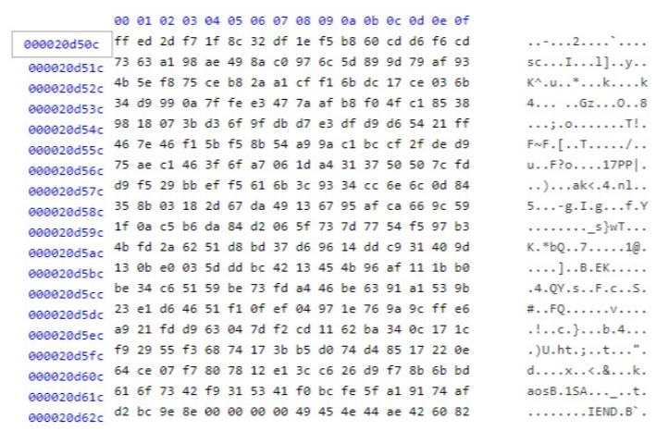
Req. 5: Hex Comparison

Slide 18
Any Questions?

